Slide 1


M.Tech Program
Advanced Industry Integrated Programs
Jointly offered by VIT University(Chennai) and LTM
Site Guard: AI Multi-Agent Construction Safety & Quality Incident Resolution System
S K Sricharan
T-SERIES: T9984
Knowledge partner | Implementation partner

Slide 2
Site Guard: AI Multi-Agent Construction Safety
Introduction
Large EPC construction sites generate thousands of free-text safety observations, near-misses, NCRs and DPRs across contractors; engineers manually cross-reference IS codes, BOCW norms and past logs, taking hours per incident with inconsistent root-cause tracking.
Site Guard AI is a LangGraph multi-agent system — Intake → Retrieval → Root-Cause → Corrective Action → Escalation — that turns a free-text report into a structured incident, a code-grounded root-cause analysis, a CAPA with an owner and due date, and an automatic escalation for critical/repeat violations.
Outcome: root-cause turnaround drops from hours to minutes, repeat violations are caught automatically, and every recommendation is traceable to a real IS-code/BOCW clause.
As a product, Site Guard AI ships as an incident-queue dashboard with an agent-reasoning trace and CAPA tracker — deployable fully local (Docker Compose + Ollama) for cost-free pilots, or on Azure (ACI/AKS) for scaled EPC deployments.

Slide 3
Site Guard: AI Multi-Agent Construction Safety
Objective
Structure free-text safety/quality reports into a consistent schema (site, contractor, severity, trade) via the Intake Agent
Build a RAG knowledge base over IS codes, the BOCW Act/Rules and site SOPs for the Retrieval Agent
Perform chain-of-thought root-cause analysis against a construction-specific FMEA/5-Why library
Draft corrective/preventive actions (CAPA) with a responsible party and due date
Auto-escalate Critical-severity or repeat-violation incidents to the safety officer
Orchestrate all five agents as a LangGraph state machine with human-in-the-loop review points
Support both a fully local (Ollama + Llama 3.1 8B) and a cloud (Azure OpenAI) deployment path

Slide 4
Site Guard: AI Multi-Agent Construction Safety
Scope
Area | In-Scope | Out-of-Scope
Data | Synthetic DPR/NCR/observation generator (5,000–15,000 records) calibrated to OSHA SIR & DGFASLI statistics | Real, site-identifying incident records (contractual/PII-sensitive)
Knowledge base | RAG over real IS codes, BOCW Act/Rules, OSHA 29 CFR 1926, and synthetic SOPs | Non-construction regulatory domains
Agents | Intake, Retrieval, Root-Cause, Corrective Action and Escalation agents in LangGraph | Autonomous CAPA closure without human sign-off
Root-cause | FMEA/5-Why chain grounded in a curated failure-mode library | Physical/forensic accident reconstruction (e.g., structural failure simulation)
Interface | Incident queue, agent-reasoning-trace view, CAPA tracker (Streamlit/React) | Worker-facing mobile reporting app (future phase)
Deployment | Docker Compose (fully local) or Azure ACI/AKS (cloud) | Multi-cloud or on-premise bare-metal Kubernetes

Slide 5
Site Guard: AI Multi-Agent Construction Safety
Literature Review
# | Paper / Source (Author, Year) | Focus | Key Insight Used in Site Guard AI
1 | LangChain AI, 2024/2026 | LangGraph: building structured multi-agent LLM applications | Core orchestration framework adopted for the Intake→Escalation agent graph
2 | Baek, Park & Jung, 2025 (Automation in Construction) | RAG-enhanced automated safety-risk-management guidance | Precedent for grounding safety recommendations in retrieved code text
3 | Bernardi, Cimitile & Pecori, 2024 (IJCNN) | Automatic job-safety report generation using RAG-based LLMs | Validates RAG for generating structured safety documentation
4 | ASCE J. Mgmt. in Engg., 2025/26 | LLM-based multi-agent system for construction job-safety analysis | Closest published precedent for a multi-agent safety-analysis pipeline
5 | Chen et al., 2025 (Adv. Eng. Informatics) | Meet2Mitigate: LLM framework for real-time issue ID from site meetings | Informs the Intake Agent's free-text-to-structured-issue extraction

Slide 6
Site Guard: AI Multi-Agent Construction Safety
Literature Review (contd.)
# | Paper / Source (Author, Year) | Focus | Key Insight Used in Site Guard AI
6 | Ahmadi, Muley & Wang, 2025 (J. Intelligent Constr.) | LLMs (GPT-4, Gemini, Llama 3.1) for construction accident-report analysis | Llama 3.1 8B chosen partly on this paper's reported accuracy
7 | Wang et al., 2026 (ECAM) | Parameter-efficient fine-tuned LLMs + ensembles for accident-report classification | Considered for fine-tuning the local Llama 3.1 8B Intake Agent
8 | Zhang, 2022 (Int. J. Constr. Mgmt.) | Hybrid deep neural network + Word2Vec for accident-cause classification | Baseline for structured cause-taxonomy design
9 | ScienceDirect, 2020 | Deep learning + network analysis for classifying accident narratives | Informs the FMEA/5-Why failure-mode taxonomy structure
10 | ScienceDirect (graph-based DL) | Graph-based deep learning for accident injury-type/body-part extraction | Considered for future enrichment of the incident schema

Slide 7
Site Guard: AI Multi-Agent Construction Safety
Summary of Literature
Published work confirms LLM-based agents reliably extract structured fields (trade, severity, cause) from free-text safety narratives, and that grounding generation in retrieved code/standard text (RAG) is now the standard approach for auditable safety recommendations.
Multi-agent orchestration (LangGraph and similar frameworks) is an active 2024–2026 research area, but published multi-agent systems specific to construction safety root-cause-to-CAPA workflows remain scarce — most work stops at single-agent classification or report generation.
This gap is exactly where Site Guard AI contributes: chaining Intake → Retrieval → Root-Cause → Corrective Action → Escalation into one auditable LangGraph pipeline with a reasoning trace.

Slide 8
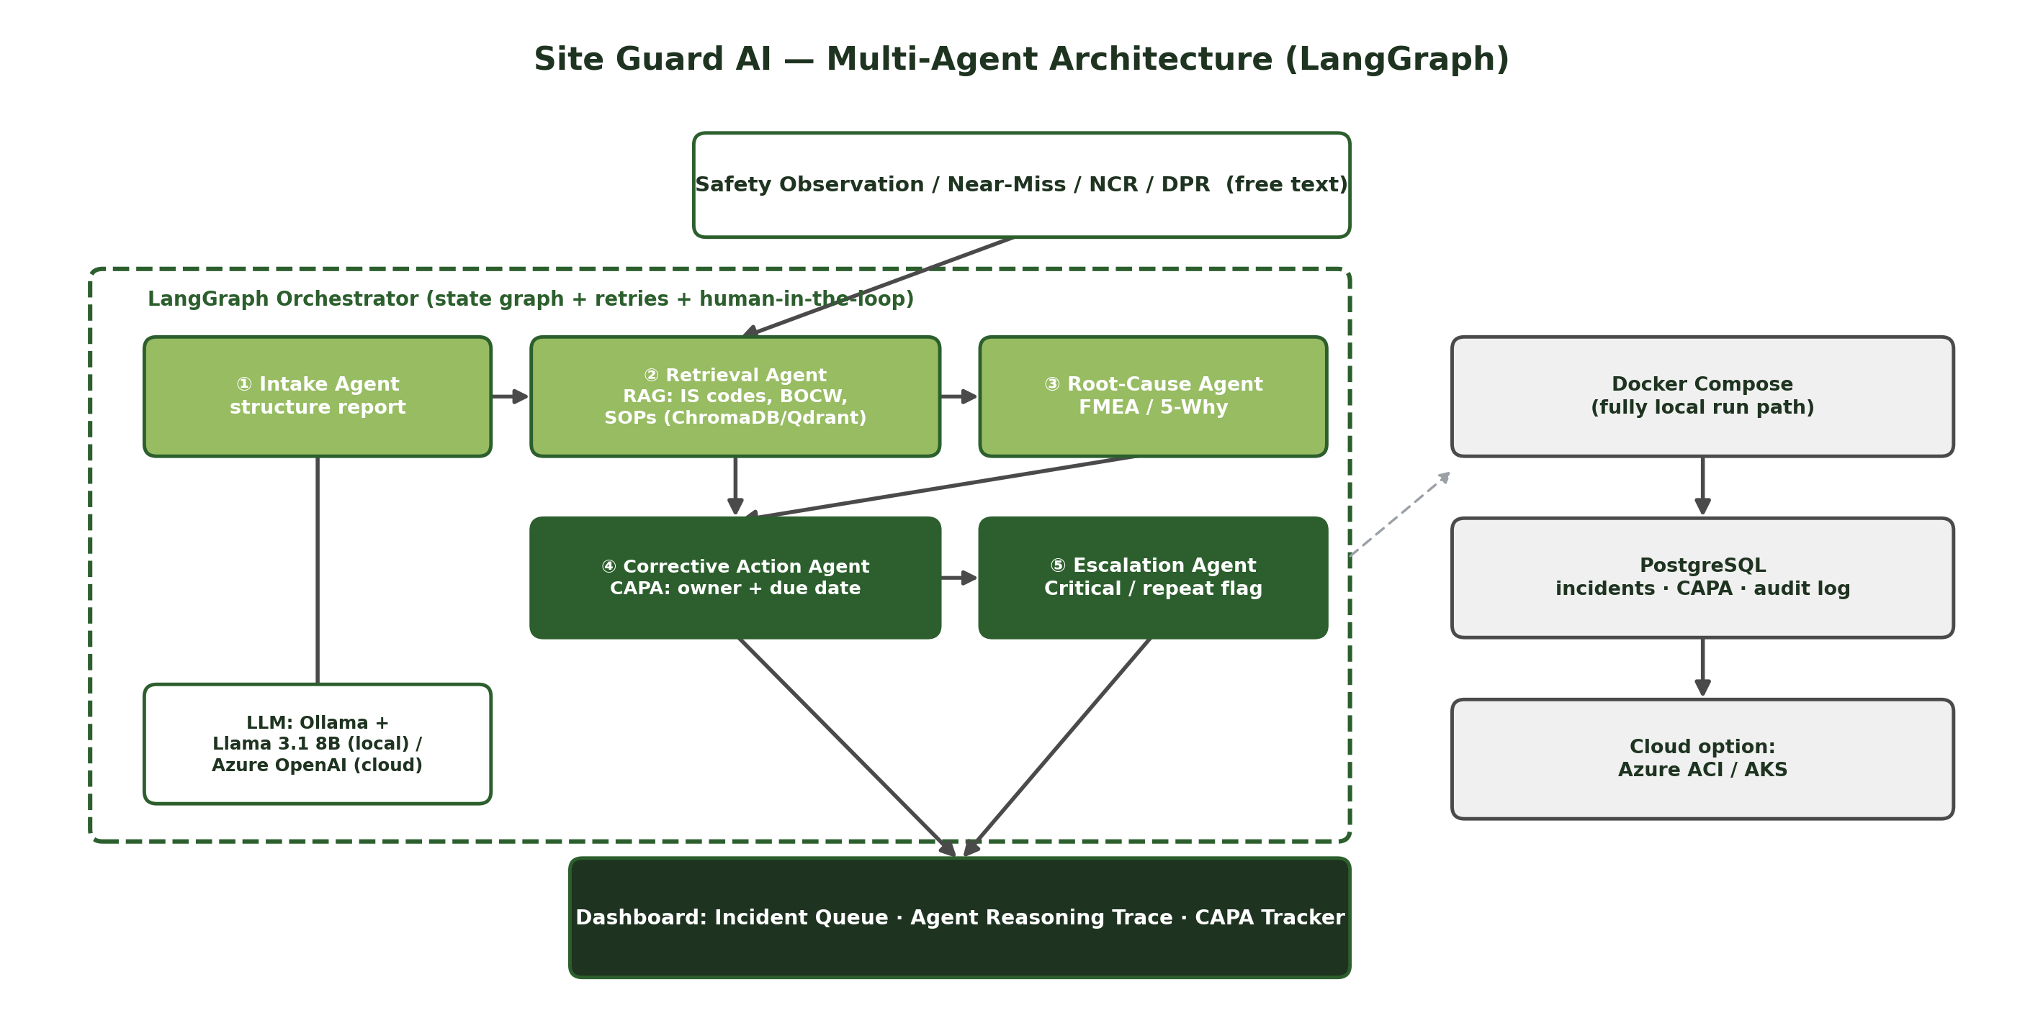
Site Guard: AI Multi-Agent Construction Safety
Architecture Diagram

Slide 9
Site Guard: AI Multi-Agent Construction Safety
Additional Information
BOCW Central Rules Chapter XIII and BIS codes such as IS 3696 (scaffolds) give Site Guard AI real, citable clause numbers — the Root-Cause Agent is designed to never fabricate a clause number, only cite verified ones.
The agent_reasoning_trace table means every escalation or CAPA can be replayed step-by-step for a safety audit — a feature most commercial EHS software doesn't expose.
Because Ollama + Llama 3.1 8B runs fully offline, Site Guard AI can be piloted on a site with no reliable internet connectivity, then switched to Azure OpenAI once the contractor scales to multiple sites.
Repeat-violation detection (same contractor/trade/site recurring) turns Site Guard AI from a passive logger into a proactive enforcement tool — a capability regulators like DGFASLI have flagged as missing in most site EHS systems.

Slide 10
Site Guard: AI Multi-Agent Construction Safety
Modules to Cover
Module | Key Tasks | Duration
1. Setup & Data Foundations | Provision Docker Compose/Azure; build synthetic DPR/NCR generator; ingest real IS codes + BOCW Act/Rules | Week 1–2
2. Knowledge Base (Retrieval Agent) | Chunk/embed IS codes, BOCW clauses, SOPs, past-incident corpus; hybrid retrieval | Week 3–4
3. Intake Agent | Free-text → structured schema via prompt design + validation | Week 3–4 (parallel)
4. Root-Cause Agent | Curate FMEA/5-Why library; chain-of-thought prompt grounded in retrieved clauses | Week 5–6
5. Corrective Action & Escalation Agents | CAPA drafting with owner/due-date; critical/repeat-violation escalation rules | Week 6–7
6. LangGraph Orchestration | Wire agents into a graph with state passing, retries, human-in-the-loop review | Week 6–7 (parallel)
7. Dashboard & API | FastAPI endpoints; incident queue, reasoning-trace, CAPA tracker UI | Week 7–8
8. Deployment & Validation | Docker Compose local path; optional ACI/AKS cloud path; end-to-end testing | Week 8–9

Slide 11
Site Guard: AI Multi-Agent Construction Safety
Module 1: Setup & Data Foundations
Week 1–2
Provision Docker Compose services (or Azure ACI) for the API, database and agent workers
Build the synthetic DPR/NCR/observation generator (5,000–15,000 records) across multiple trades/sites
Calibrate synthetic data against OSHA Severe Injury Report and DGFASLI safety statistics
Ingest real, current IS codes and BOCW Act/Rules text into the knowledge base as-is

Slide 12
Site Guard: AI Multi-Agent Construction Safety
Module 2: Knowledge Base (Retrieval Agent)
Week 3–4
Chunk and embed IS codes, BOCW clauses, site SOPs and the past-incident corpus with Sentence Transformers
Stand up ChromaDB/Qdrant vector store keyed to clause_id for precise citation
Implement hybrid retrieval combining semantic similarity with keyword search
Validate retrieval against a held-out set of known code references

Slide 13
Site Guard: AI Multi-Agent Construction Safety
Module 3: Intake Agent
Week 3–4 (parallel)
Design prompts that convert free-text observations/NCRs/DPRs into a structured schema
Extract site, contractor, severity and trade fields with validation rules
Handle ambiguous or incomplete reports with a clarification/fallback path
Benchmark extraction accuracy against a manually labelled synthetic sample

Slide 14
Site Guard: AI Multi-Agent Construction Safety
Module 4: Root-Cause Agent
Week 5–6
Curate a construction-specific FMEA/5-Why failure-mode library
Design chain-of-thought prompts that ground root-cause reasoning in retrieved clauses
Ensure every root-cause explanation cites a verified IS-code/BOCW reference, never a fabricated one
Validate root-cause quality against past-incident precedents in the corpus

Slide 15
Site Guard: AI Multi-Agent Construction Safety
Module 5: Corrective Action & Escalation Agents
Week 6–7
Draft CAPA (corrective/preventive action) text with a responsible party and due date
Design escalation rules for Critical-severity incidents and repeat-violation patterns
Route escalations to the safety officer with full context and reasoning trace
Log every CAPA and escalation to the audit trail for compliance reporting

Slide 16
Site Guard: AI Multi-Agent Construction Safety
Module 6: LangGraph Orchestration
Week 6–7 (parallel)
Wire the five agents into a LangGraph state graph with typed state passing
Add retry logic and human-in-the-loop checkpoints before CAPA/escalation commit
Implement graph-level logging so every run can be replayed step-by-step
Test end-to-end graph execution on synthetic incident batches

Slide 17
Site Guard: AI Multi-Agent Construction Safety
Module 7: Dashboard & API
Week 7–8
Build FastAPI + Pydantic endpoints for incident intake, retrieval and agent orchestration
Build the incident-queue dashboard with an agent-reasoning-trace view (Streamlit/React)
Build the CAPA tracker with owner, due-date and status views
Wire the dashboard to PostgreSQL for incidents, CAPA and the audit trail

Slide 18
Site Guard: AI Multi-Agent Construction Safety
Module 8: Deployment & Validation
Week 8–9
Package all services with Docker Compose for the fully local run path
Configure the optional Azure ACI/AKS cloud deployment path
Run end-to-end testing across synthetic incidents spanning multiple trades/sites
Prepare documentation: schema reference, agent-prompt library, deployment runbook, demo

